Slide 1

Ch-7 Introduction to Pentium Architecture

Slide 2
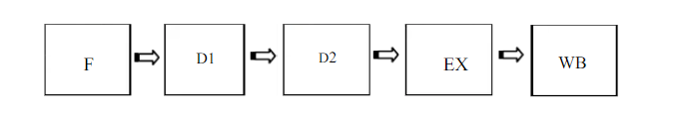
Features of Pentium Processor :
Pentium Processor is fifth generation microprocessor evolved in 1993.
It has a 32-bit address bus
Address bus is 32-bit hence can access 2³² = 4GB memory.
It has 64-bit data bus
Pentium Processor designed to operate from 60MHZ to 233 MHZ
It has 5 stage pipelining .
It is 2 way superscalar : U pipe , V pipe
On chip floating point unit
Branch prediction logic : 256 entry BTB
On chip cache memory
Instruction cache has 8K bytes memory
Data cache has 8K bytes memory
Cache is a small amount of memory which is a part of the CPU - closer to the CPU than RAM .
It is used to temporarily hold instructions and data that the CPU is likely to reuse.
State any 3 / 4 features of Pentium processor. 3 / 4 Mks

Slide 3
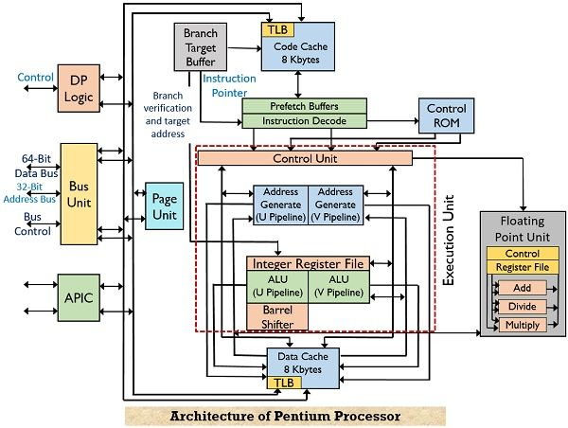
Pentium superscalar architecture :

Slide 4
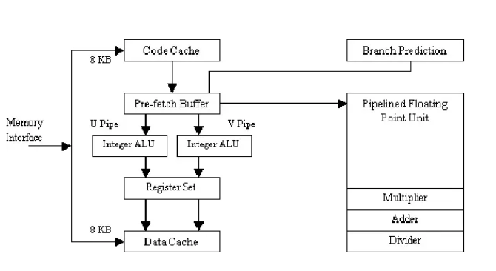
Pentium superscalar architecture :

Slide 5
Processors capable of parallel instruction execution of multiple instructions are known as Superscalar.
The Pentium processor is a superscalar machine, capable of executing two instructions in parallel.
The process of issuing two instructions in parallel is called as dual pairing.
Given figure presents a block diagram overview of the Pentium Processor including two instruction pipelines because of dual pipelining feature.
1. “U” pipe : The U-pipe can execute all integer and floating point
instructions.
2. “V” pipe : The V-pipe can execute simple integer instructions
and floating point instructions.
There are two separate cashes are there in the block diagram :
1. Instruction cache (code cache)
2. Data cache
There are 2 separate 32 bit ALU to perform 64 bit data operation.
5-stage or dual pipelining and branch prediction are two advance and important features of Pentium processor.

Slide 6
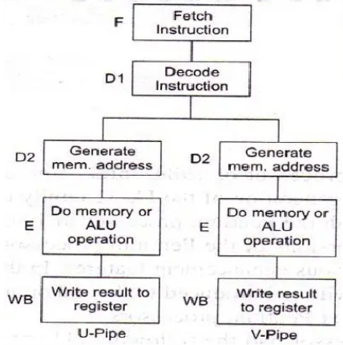
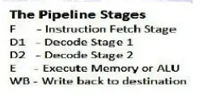
Pipelining :

Slide 7
Pipelining :
Each of the two pipelines have five stages:
Prefetch (F) : Instructions are prefetched from instruction cache or memory.
D1 instruction decode : In the D1 stage, the processor decodes the instruction to generate a control word. A single control word executes instruction directly.
D2 Address generate : In the D2 stage, the processor decodes the control word from D1 for use in the EX stage.
Execute (EX) : In this stage, the processor either accesses the data cache or calculates results in the ALU.
Write Back (WB) : In the WB stage, the processor updates the registers and flags with the instructions result.

Slide 8
Instruction Branch Prediction:
Why do we need branch prediction?
The gain produced by Pipelining can be reduced by the presence of program transfer instructions eg JMP, CALL, RET etc .
2. They change the sequence causing all the instructions that entered the pipeline after
program transfer instructions invalid.
3. Thus no work is done as the pipeline stages are reloaded.

Slide 9
Branch prediction logic:
To avoid this problem, Pentium uses a scheme called Dynamic Branch Prediction.
In this scheme, a prediction is made for the branch instruction currently in the pipeline. The prediction will either be taken or not taken.
If the prediction is true then the pipeline will not be flushed and no clock cycles will be lost.
If the prediction is false then the pipeline is flushed and starts over with the current instruction.
It is implemented using 4 way set associated cache with 256 entries.
This is called Branch Target Buffer (BTB).
The directory entry for each line consists of:
Valid bit: Indicates whether the entry is valid or not.
History bit: Track how often bit has been taken.
Source memory address is from where the branch instruction was fetched. If the directory entry is valid then the target address of the branch is stored in corresponding data entry in BTB.

Slide 10
Working of Branch Prediction:
BTB is a lookaside cache that sits to the side of Decode Instruction(DI) stage of 2 pipelines and monitors for branch instructions.
The first time that a branch instruction enters the pipeline, the BTB uses its source memory to perform a lookup in the cache.
Since the instruction was never seen before, it is BTB miss. It predicts that the branch will not be taken even though it is unconditional jump instruction.
When the instruction reaches the EU(execution unit), the branch will either be taken or not taken.
If taken, the next instruction to be executed will be fetched from the branch target address.
If not taken, there will be a sequential fetch of instructions.
When a branch is taken for the first time, the execution unit provides feedback to the branch prediction.
The branch target address is sent back which is recorded in BTB.
A directory entry is made containing the source memory address and history bit is set as strongly taken.

Slide 11
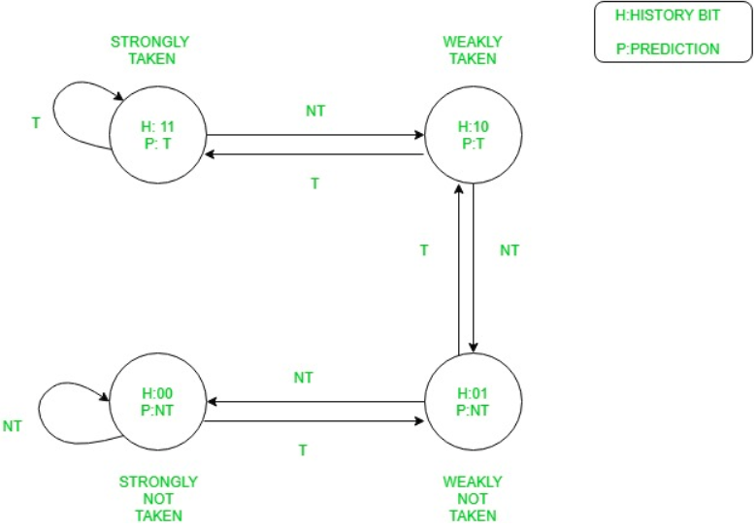
History Bits | Resulting Description | Prediction made | If branch taken | If branch not taken
11 | Strongly Taken | Branch Taken | Remains in same state | Downgraded to weakly taken
10 | Weakly Taken | Branch Taken | Upgraded to strongly taken | Downgraded to weakly not taken
01 | Weakly Not Taken | Branch Not Taken | Upgraded to weakly taken | Downgraded to strongly not taken
00 | Strongly Not Taken | Branch Not Taken | Upgraded to weakly not taken | Remains in same state

